Slide 1
Open and Short Circuit Test of Transformer
Open and short circuit tests are performed on a transformer to determine the:
Equivalent circuit of transformer
Voltage regulation of transformer
Efficiency of transformer
The power required for open circuit tests and short circuit tests on a transformer is equal to the power loss occurring in the transformer.

Slide 2
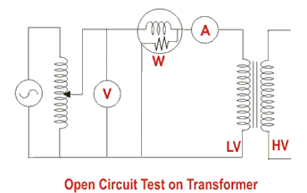
Open Circuit Test on Transformer
The connection diagram for open circuit test on transformer is shown in the figure.
A voltmeter, wattmeter, and an ammeter are connected in LV side of the transformer as shown.
The voltage at rated frequency is applied to that LV side with the help of a variac of variable ratio auto transformer.
The HV side of the transformer is kept open.
Now with the help of variac, applied voltage gets slowly increased until the voltmeter gives reading equal to the rated voltage of the LV side.
After reaching rated LV side voltage, we record all the three instruments reading (Voltmeter, Ammeter and Wattmeter readings).

Slide 3
The ammeter reading gives the no load current I_{e}. As no load current I_{e} is quite small compared to rated current of the transformer, the voltage drops due to this current that can be taken as negligible.
Since voltmeter reading V₁ can be considered equal to the secondary induced voltage of the transformer,
wattmeter reading indicates the input power during the test.
As the transformer is open circuited, there is no output, hence the input power here consists of core losses in transformer and copper loss in transformer during no load condition.
But as said earlier, the no-load current in the transformer is quite small compared to the full load current so, we can neglect the copper loss due to the no-load current.
Hence, can take the wattmeter reading as equal to the core losses in the transformer.

Slide 4
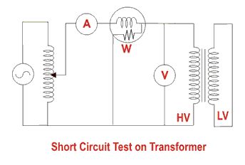
Short Circuit Test on Transformer
The connection diagram for the short circuit test on the transformer is shown in the figure below.
A voltmeter, wattmeter, and an ammeter are connected in HV side of the transformer as shown.
A low voltage of around 5-10% is applied to that HV side with the help of a variac (i.e. a variable ratio auto transformer).
We short-circuit the LV side of the transformer. Now with the help of variac applied voltage is slowly increased until the wattmeter, and an ammeter gives reading equal to the rated current of the HV side.
After reaching the rated current of the HV side, we record all the three instrument readings (Voltmeter, Ammeter and Watt-meter readings).

Slide 5

The ammeter reading gives the primary equivalent of full load current IL.
As the voltage applied for full load current in a short circuit test on the transformer is quite small compared to the rated primary voltage of the transformer, the core losses in the transformer can be taken as negligible here.
Let’s say, voltmeter reading is V_{sc}. The watt-meter reading indicates the input power during the test.
As we have short-circuited the transformer, there is no output; hence the input power here consists of copper losses in the transformer.
Since the applied voltage V_{sc} is short circuit voltage in the transformer and hence it is quite small compared to the rated voltage, so, we can neglect the core loss due to the small applied voltage.
Hence the wattmeter reading can be taken as equal to copper losses in the transformer. Let us consider wattmeter reading is P_{sc}.
Where, R_{e} is equivalent resistance of transformer.
Hence the short-circuit test of a transformer is used to determine copper losses in the transformer at full load

